Slide 1
<NPS Prediction>
Dear pioneer/intrapreneur/dreamer/colleague!
We are so excited that you have an idea that you would like to explore and develop with us. Together, we can make it happen!
This template is a way for you (and possibly your team) to collect what you currently know about this idea. The purpose is to provide a basis for a good discussion with innovation coaches on how NDO Innovation Engine team (or possibly others) can support your idea moving forward.
Throughout the template, these boxes will be a guide about what type of information we would like to see (before you present, you can go ahead and delete them). Orange text is also merely there for guidance, and text surrounded by <> are questions that can be a guide.
The structure and visuals throughout this template is merely a suggestion, so if you have a better way to present your idea, go ahead and do that!
And don’t hesitate to reach out to if you need any help!
Best regards,
BMAS Innovation team
Idea Description, Business Case & Realization Plan
Idea contact person: <> Kuldeep Jain
Other team members: <> Nikhil Tyagi
Template version: rev G (2020-05-15)

Slide 2
Your Elevator Pitch
The aim of this slide to explain what real word opportunity your idea is based on. What are the reasons for why this opportunity exists? Show us how you have validated the opportunity in the “real world”, for example by talking to somebody inside or outside Ericsson, reliable data you have found or that you have made an observation.
Today, one of the largest risks to telecommunications companies is an inability to understand customer values. How did this happen? For decades, telecom companies focused on building the largest network and charging customers for service bundles through long-term, binding agreements. Most of the revenue came through voice traffic and long-distance calling. And for a while, this strategy worked.
However, too many companies benefited from bad profits. This is when a company makes profit through unfair or deceptive pricing, i.e., roaming charges.
NPS Score predication will help in arresting the problem at inital stage
What is the innovation about?
How will it work?
What problems will it solve?
What costs will it reduce?
What new revenue streams will it open?

Slide 3
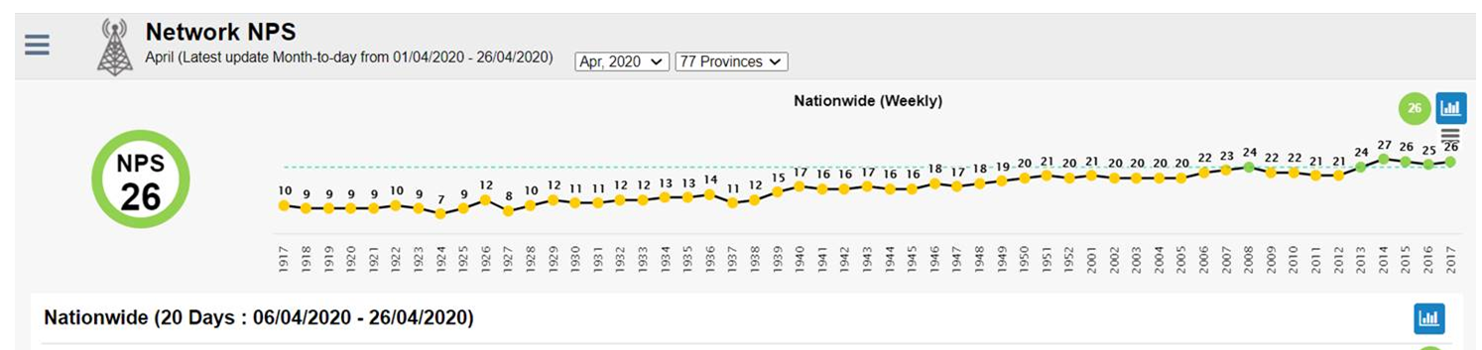
The idea in more detail
Here is where your idea gets to shine! Illustrate and describe your vision for your idea as clearly and concisely you can. See this as a sketch of what you’d like to achieve in the end.
VISUALIZATION
DESCRIPTION
...

Slide 4

















The impact/value in more detail
Reflect on how your idea impacts society at large, the customers/users it is aimed at, and Ericsson.
The focus should be on how the idea provides value. Remember that value could and should include much more than monetary benefits!
CUSTOMER/USER IMPACT
ERICSSON VALUE
Optional
SOCIETAL IMPACT
Operators
Increase revenue
(Consider both HW, Services and SW sales)
. Revenue/Margins/Up sales/New customer segments this idea can generate

Slide 5
Who else?
The aim of this slide is to outline what other actors you have seen acting on the same opportunity as you. It can be a similar product, or that they are trying to go for the same market. In the future these actors could become partners, suppliers, customers or even competition depending on how you set up the business model.
It might make sense to group these actors if they are many.
<
Ericsson have technology leadership with a unique mix of global and local expertise to enable operators to meet their business objectives. We help you take advantage of Ericsson’s global support insights and innovations, transform network operations and be proactive.

Slide 6
IPR & Patents
Consider if your idea contains any new “inventions” that is important to protect in terms of IPR & Patents.
If a patent application is approved you are eligible for monetary awards.
See next, hidden slide for more information.
Patent applicable? <Yes/No>
Patent filing status to date: <Submitted to patent office/Under review/Approved/Rejected/Not applicable>
If not sure, reach out Contact person → Cao Cao

Slide 7
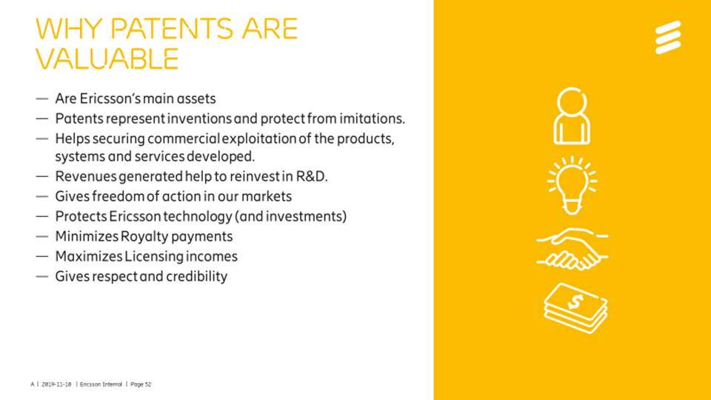
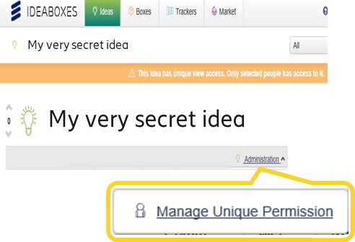
Patent & IPR information
Do’s and Don’ts
If your idea contain potential patents submit IvD to Ericsson patent unit first to avoid risk of competitors filing patents before us. If you don’t know if patent worthy…
In the IVD template state project “BMAS Innovation”
Don’t spread invention details to everyone until patent application has been filed
While waiting for patent review, submit idea in IdeaBox to qualify for innovation competition, but restrict access to your idea in IdeaBoxes;
Learn more at Patent & IPR homepage
Why patents are valuable for you
Get further recognition
Qualify for Inventor Awards and Renumeration (if idea is feasible for patent application)
How to file patents?
Submit an Invention Disclosure (IvD) according to Patent & IPR instructions here
People who should have access to your secret idea:
Your co-inventors
Your local Innovation Ambassador
Your SA Innovation Program Manager
Expert involved in idea review (later)
Questions about Patents? Contact person → Cao Cao

Slide 8
Business Case estimation
N.B. Not mandatory to use in first idea submission!
If idea is deemed interesting, Innovation Ambassador will reach out and ask you/help you to elaborate this business case.
Sales Support will help validate business cases for short-listed ideas, and may reach out to clarify/calibrate estimations.
To edit tables in full screen, choose either of below:
Right-click table, choose menu Worksheet Object → “Open”
View in presentation mode, and click table to open in Excel
If above does not work you can download Excel template here – then please attach Excel file in your Power Point template
N.B. Grey fields are automatically calculated/default – don’t change.

Slide 9
Business Case assumptions
N.B. Not mandatory to use in first idea submission!
If idea is deemed interesting, Innovation Ambassador will reach out and ask you/help you to elaborate this business case.
This slide helps us understand your reasoning behind your business case estimations and is required if you have a business case
<Add description/illustration of the calculation assumptions you have made for your business case so we can understand the logic behind the business case.>
Business/Revenue increase assumptions (if applicable)
<E.g. Cost of Delivery – what assumptions were used; which delivery activities and costs>
Cost/Efficiency savings (if applicable)
<E.g. Total time it takes today – what assumptions were used?
E.g. Total time after efficiency improvements – what assumptions were used?>

Slide 10
Realization plan (Minimum Viable Product, MVP)
Mandatory for final idea review!
In this slide we’d like you to outline what your realization plan for your idea – at least the first “Minimum Viable Product (MVP)” or “first launch”.
END GOAL
TEST
<What would you like to test with the prototype? It could be technical, but most likely it is about how humans respond to your idea>
<With which users do you think it is relevant to test it?>
SCOPE, KEY COMPONENTS
<Description of scope, key components>
TIME PLAN
<Description of key milestones and time line for development>
RESOURCES & INVESTMENTS NEEDED
<Think about what resources you need to make this a reality, could be financial, human, or other>
<What are the investments required after MVP to deliver on the business case?>
<Return on Investment analysis>
RISKS
<Think about key risks to mitigate>
Sketch your end goal for your idea! It’s a good idea to use the same sketch as in the idea slide.

Slide 11
ROI
Optional for innovator
Sales Support will create this slide – IF idea is selected and shortlisted

Slide 12
Commercial Viability & Strategic Fit
Optional for innovator
R&D unit (SME) will create this slide – IF idea is selected and shortlisted
Commercial Viability & Risks:
<Consider and elaborate if idea will scale across different markets/customers>
<E.g. Idea supporting multi vendor?>
<E.g. Idea supporting multiple markets/customers, or only 1 specific market/customer use case?>
<Mention any commercial risks if any, and if you have any mitigation proposals>
<E.g. SW with risk of undercutting existing Services sales/up sales?>
Strategic/Portfolio Fit:
<Consider and elaborate if idea complements/contradicts current existing product/service offering, e.g. in terms of current features or future strategy/roadmaps>

Slide 13
Plan for Rapid Prototype and Shark Tank Pitch
Optional – but highly recommended in order to prepare you for Shark Tank event!
In this slide we’d like you to outline what you plan for a rapid prototype, demo, or whatever format you will present at Shark Tank. A rapid prototype is like a sketch of the concept. Remember, a prototype can be a sketch, a ppt or a cardboard model, so it does not need to be fancy nor fully functional.
END GOAL
TEST/DEMONSTRATE
<What would you like to test/demo with the prototype? It could be technical, but most likely it is about how humans respond to your idea>
<With which users do you think it is relevant to test it?>
KEY COMPONENTS
Sketch your end goal for your idea! It’s a good idea to use the same sketch as in the idea slide.
<Description of key components of the planned prototype>
TIME PLAN
Timeline for preparing for Shark Tank event
RESOURCES NEEDED
<Think about what resources you need to make this a reality, could be financial, human, or other>

Slide 15
Revision history of template
Revision | Date | Comments
A-D | 2019 | Used in NDO Innovation 2019
E | 2020-02-19 | Revised for 2020 BMAS Innovation Challenge (added slide 7 - business case assumption)
F-G | 2020-05-15 | Added examples of business case parameters for customer/Ericsson (slide 4) Added question if patent is applicable and information on how to file (slide 6-7) Clarified when business case is applicable, and support available (slide 8-10) Added new slide about Commercial Risks and Strategic Fit (slide 11)

Slide 16
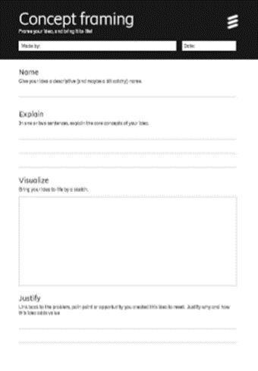
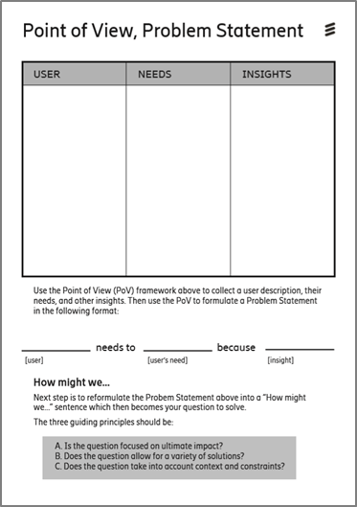
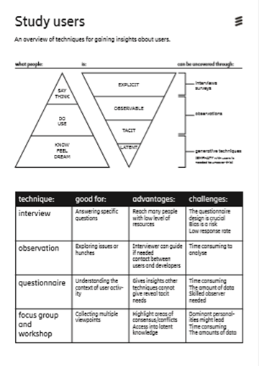
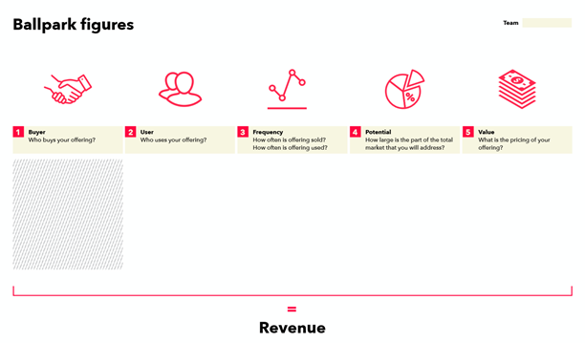
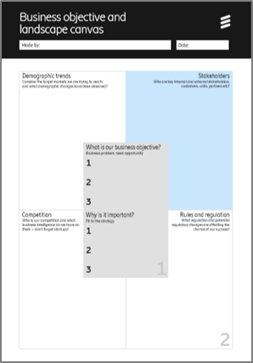
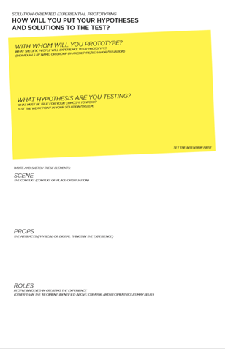
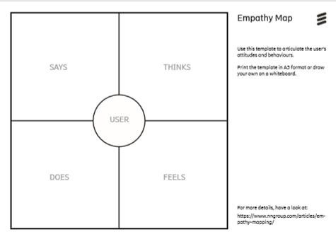
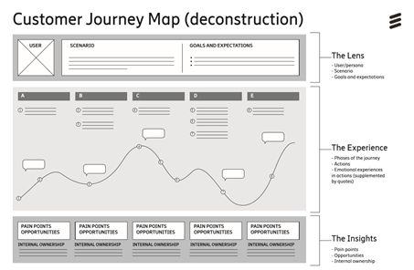
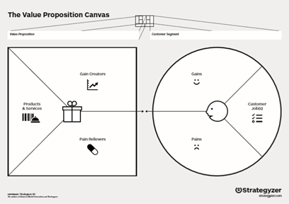
Further useful material that could be used
Ericsson ONE templates (see section “Tools”)

